Slide 1
DESIGN AND ANALYSIS OF ALGORITHMS
Dr Y V K Ravi Kumar, BITS- Pilani

Slide 2
Dynamic Programming – Matrix Chain Multiplication

Slide 3
Matrix chain multiplication problem involves determining the optimal sequence for performing a series of operations.
Applications:
Code optimization in Compiler design
Query optimization in Database

Slide 4
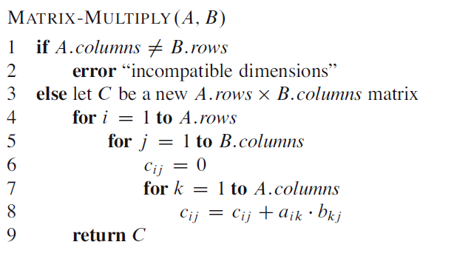
MATRIX MULTIPLICATION

Slide 5



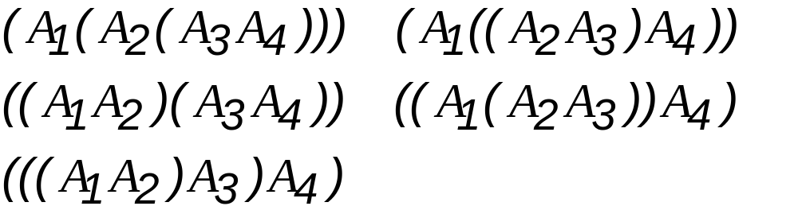
How to compute where is a matrix for every i.
Example:

Slide 6
Example
Consider three matrices A,B,C of order 5x4,4x3 and 3x5 respectively.
Now the product (AB)C = {(5x4)(4x3)}(3x5)
= 5x4x3 + 5x3x5 = 135
A(BC) = 4x3x5 + 5x4x5 = 160
From this it is very clear that by changing the evaluation sequence, the cost of operations also changes

Slide 7
A product of matrices is fully parenthesized if it is either a single matrix, or the product of two fully parenthesized matrix product, surrounded by parentheses.

Slide 8
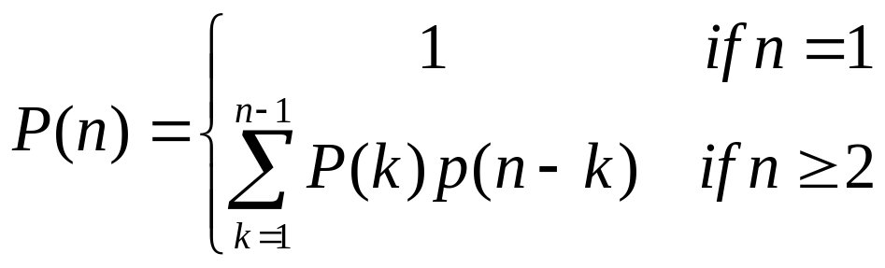
Counting the number of Parenthesizations
P(n) is the number of alternative parenthesizations of a sequence of n matrices

Slide 9
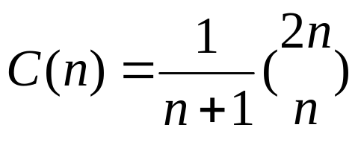
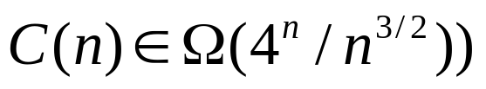
This is related to a famous function in combinatories called as Catalan numbers.
P(n) = C(n-1) where C(n) is the nth catalan number
Applying Stirling’s formula we find that

Slide 10
Matrix chain multiplication Problem
Given a sequence of Matrices A1,A2…An and dimensions P0,P1……Pn where Ai is of dimension Pi-1xPi ,determine the order of multiplication that minimizes the number of operations

Slide 11
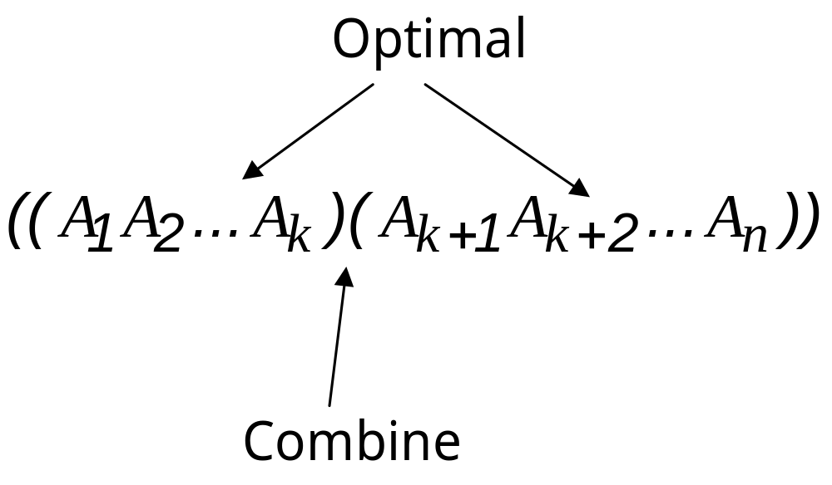
Step 1: The structure of an optimal parenthesization

Slide 12
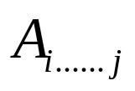

Step 2: Recursive Solution(contd..)
We will store the solutions to the subproblems in a table and build the table in a bottom up fashion.
Let m[i,j] denote the minimum number of multiplications needed to compute for some
The optimum cost can be described by the following formulation

Slide 13
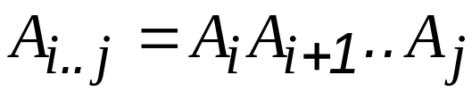
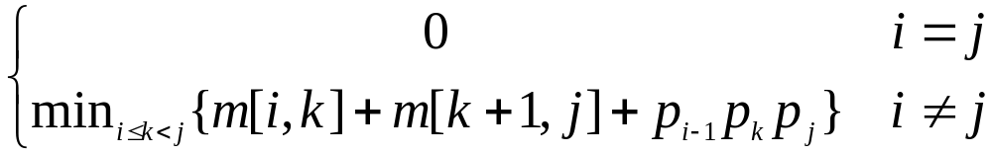
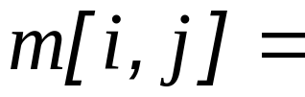
Step 2: A recursive solution
Define m[i,j]= minimum number of scalar multiplications needed to compute the matrix

Slide 14
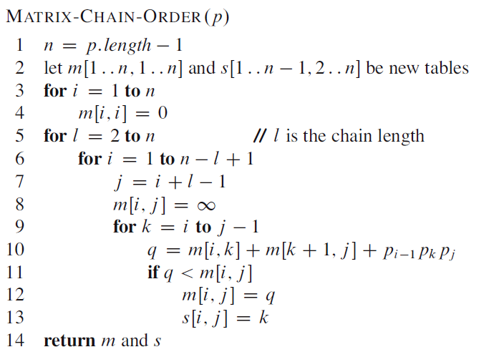
Step 3:Computing the optimal costs

Slide 15
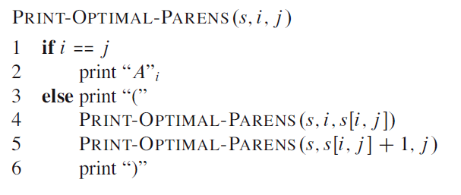
Step 4:Construct an optimal solution

Slide 16
Example(MCM)
Consider four matrices of orders 20x30, 30x50, 50x10, 10x5.Find the optimal sequence for the matrix chain product

Slide 17
P = <20,30,50,10,5>
 | 1 | 2 | 3 | 4
1 | 0
2 |  | 0
3 |  |  | 0
4 |  |  |  | 0

Slide 18
m(1,2) = m(1,1)+m(2,2)+P0P1P2 = 0+0+20.30.50
m(2,3) = m(2,2)+m(3,3)+P1P2P3 = 0+0+30.50.10
m(3,4) = m(3,3)+m(4,4)+P2P3P4 = 0+0+50.10.5
 | 1 | 2 | 3 | 4
1 | 0 | 30000
2 |  | 0 | 15000
3 |  |  | 0 | 2500
4 |  |  |  | 0

Slide 19
m(1,3) = m(1,1)+m(2,3)+P0P1P3 = 0+15000+20.30.10 = 21000
= m(1,2)+m(3,3)+P0P2P3 = 30000+0+30.50.10 = 45000
m(2,4) = m(2,2)+m(3,4)+P1P2P4 = 0+2500+30.50.5 = 10000
= m(2,3)+m(4,4)+P1P3P4 = 15000+0+30.10.5 = 16500
 | 1 | 2 | 3 | 4
1 | 0 | 30000 | 21000
2 |  | 0 | 15000 | 10000
3 |  |  | 0 | 2500
4 |  |  |  | 0

Slide 20
m(1,4) = m(1,1)+m(2,4)+P0P1P4 = 0+10000+20.30.5 = 11000
= m(1,2)+m(3,4)+P0P2P4 = 30000+2500+20.50.5 =37500
= m(1,3)+m(4,4)+P0P3P4 = 21000+0+20.10.5 = 22000
 | 1 | 2 | 3 | 4
1 | 0 | 30000 | 21000 | 11000
2 |  | 0 | 15000 | 10000
3 |  |  | 0 | 2500
4 |  |  |  | 0

Slide 21
So the optimal solution to the original problem is given by m(1,4) and the corresponding value of k is found in S(1,4).
Optimal Parenthesization is (A1(A2(A3A4)

